Slide 1
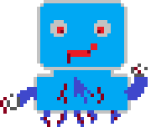
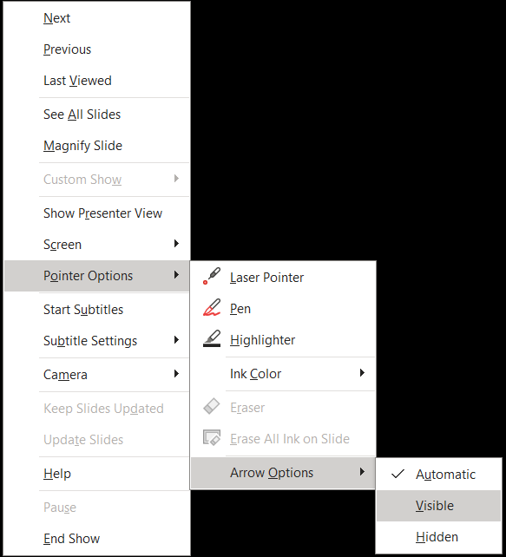
Remember to make your mouse stay visible by right-clicking and choosing the correct option, when you open the game.
Press ESCape
to hide from teacher
Isn’t there an ”L” missing from that...
Click to chalenge...
Whatever that thing is

Slide 10
W
He got tired and you won
Leave game
Do it again
ESC button

Slide 11
L
I found the missing ”L”!
Get back up. Try me
Rage quit

